Slide 1

Natural Language Processing with Disaster Tweets
Predictions of which Tweets are about real disasters vs which are not
Course: CSC 46000 – Intro to Data Science
Instructor: Rachel Connolly
Students: Daniel Hernandez & Justin Park

Slide 2

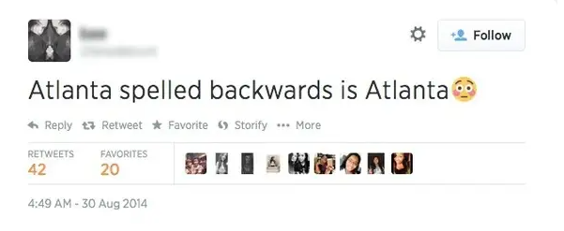
What are Tweets?
Origin of Tweets
Tweets are message posts from users to express whatever they want
Disaster Tweets

Slide 3
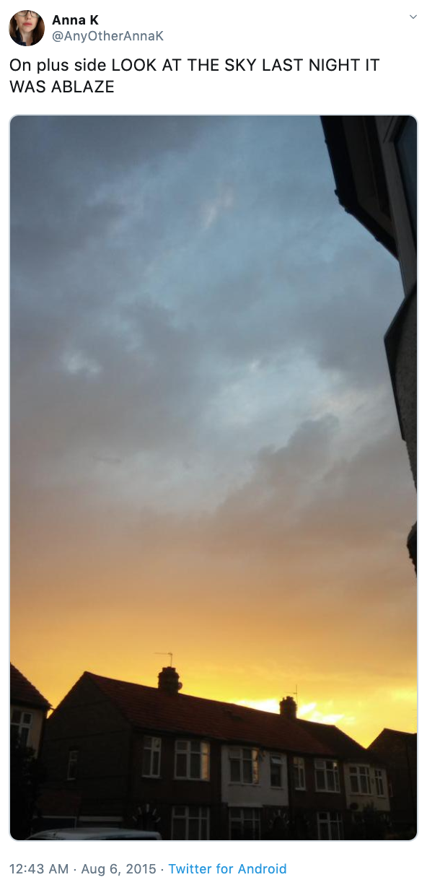
Motivation
Approximately 6,000 Tweets every second
72% of general public uses some type of social media
Important communication channel
Can we make use of the Tweets to help others?

Slide 4
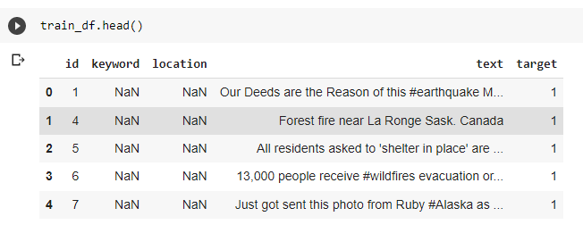
Data
Supervised dataset
Approximately 7,600 tweets
{ID, text, location, keyword, target}

Slide 5
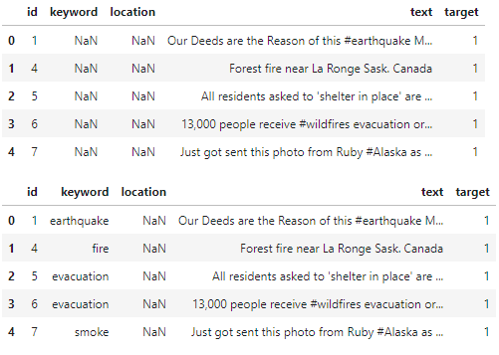
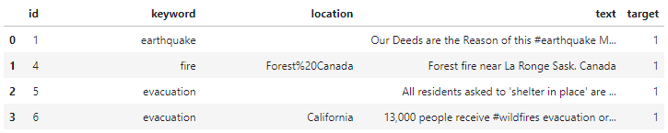
Data Preprocessing and Analysis
Natural Language Toolkit (NLTK)
Filling missing keyword and location values
Disaster vector
Set and Intersection

Slide 6
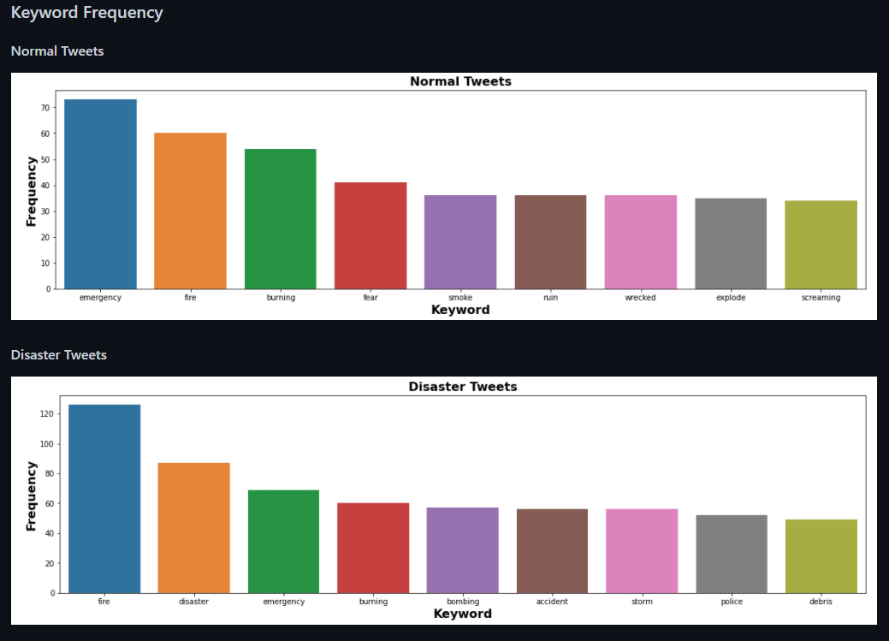
Keyword Frequency Visualization

Slide 7
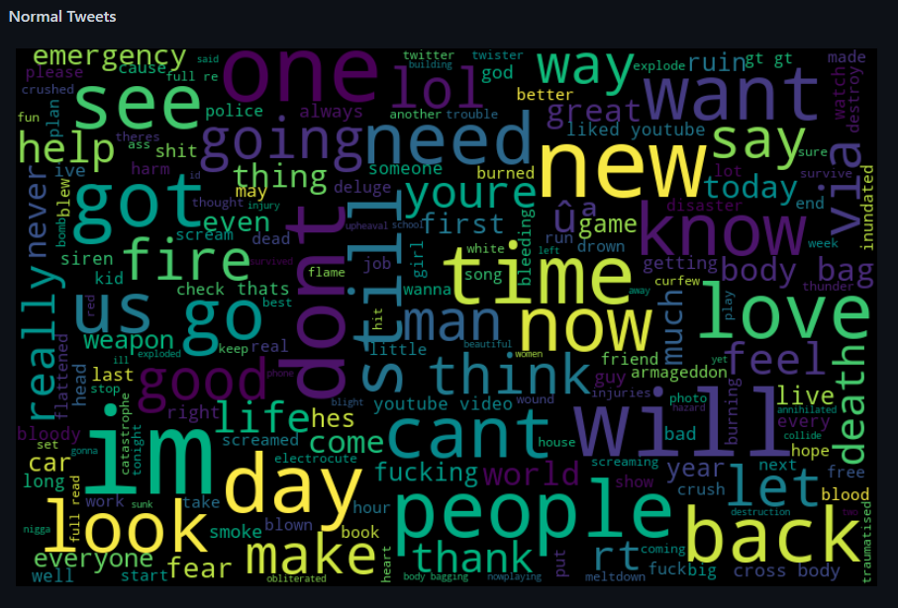
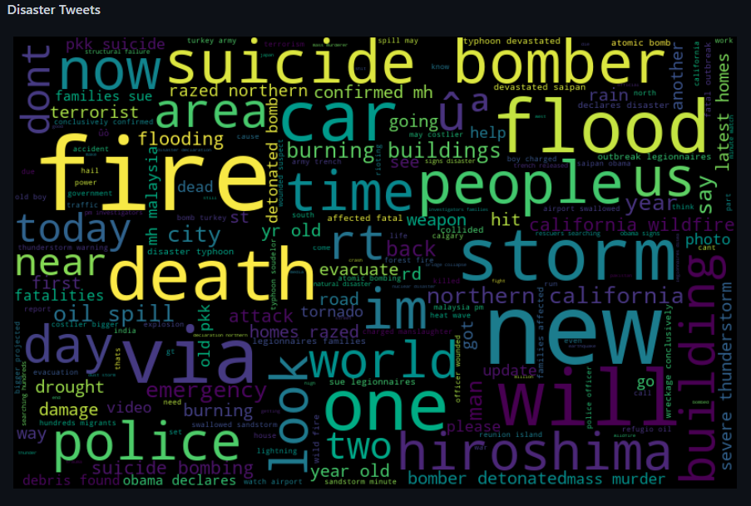
Word Cloud Visualization

Slide 8
Model Training
Extracting and transforming tweets
Tfidf_vectorizer = TfidVectorizer(max_df=0.90, min_df=2, max_features=300, stop_words=‘english’)
Train and Test Datasets

Slide 9
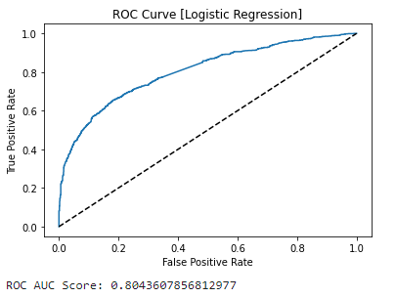

Logistic Regression
Use of Logistic Regression
Fit, predict, and score
Train and Test datasets
ROC Curve
74% accuracy & 0.80 ROC area under curve score

Slide 10
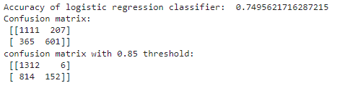
Hyperparameter Tuning
GridSearchCV
Fitting data for grid_model
Result summary
Approximate 0.5% difference

Slide 11
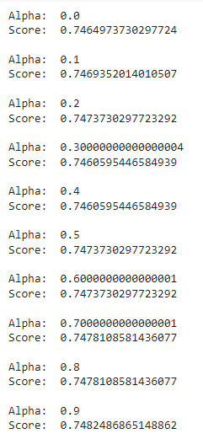
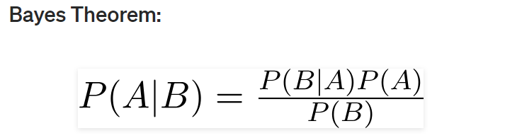
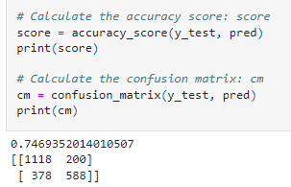
Naïve Bayes Model
What is it?
MultinomialNB()
Fit, predict, score
74.7%
Improving

Slide 12
Future Work
Different vectorizer
Using keyword and location features in models
Adjusting our true positive rate/false positive rate

Slide 13

Thank You!

